Slide 1

New Bangladesh

Slide 2
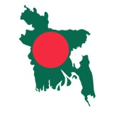
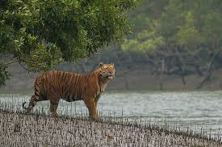
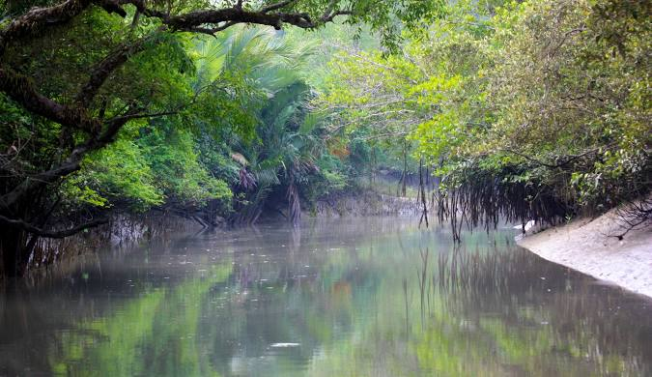
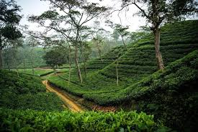
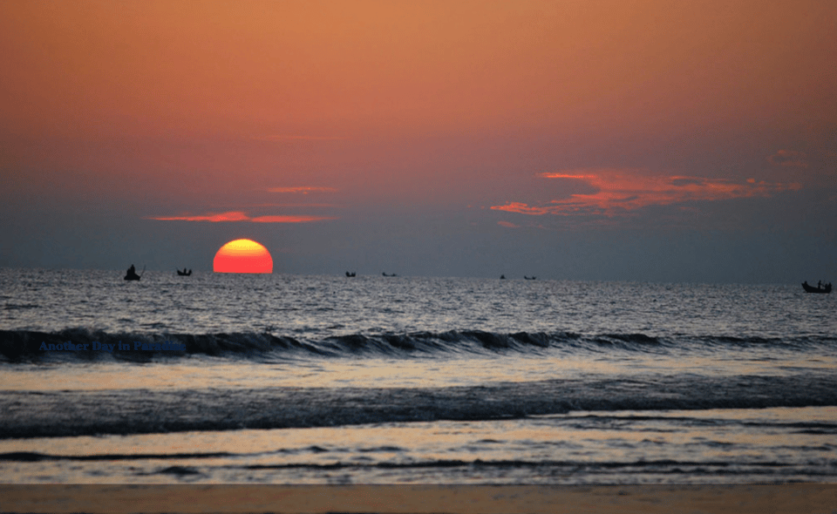
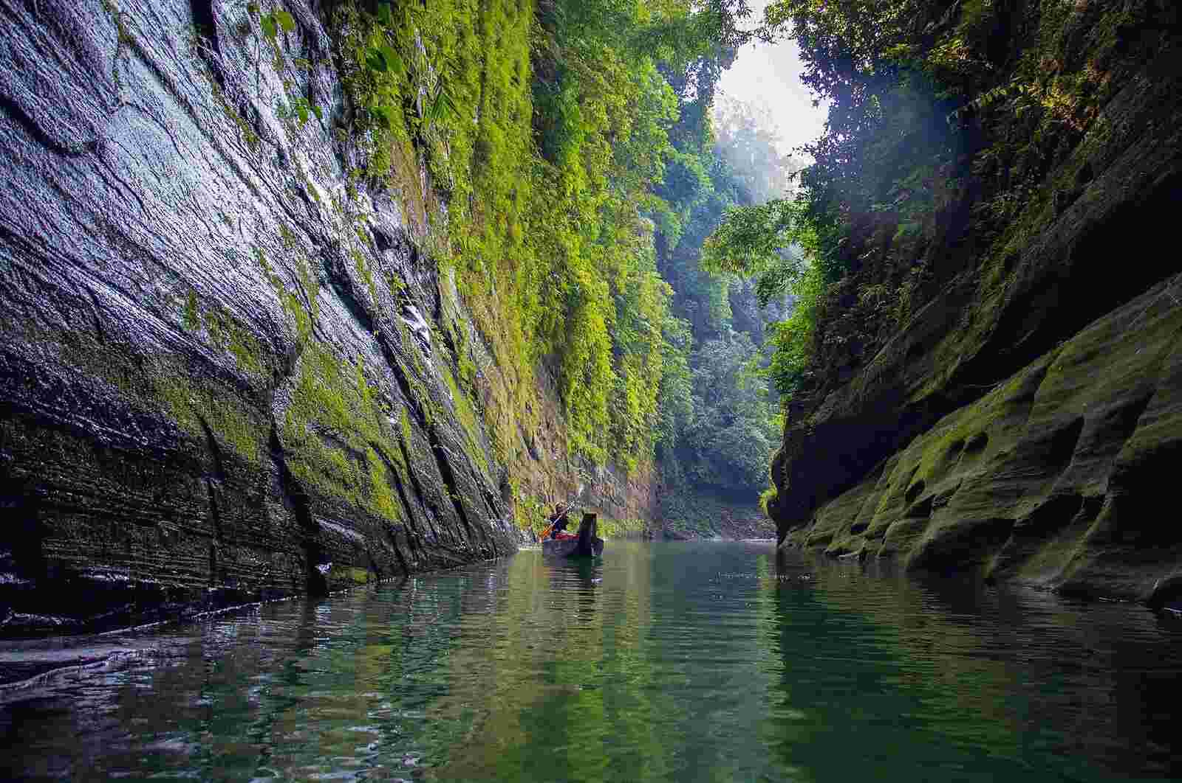
Cox’s Bazar
Sundarban
Shylhet
Kuakata
Bandarban
Go to 5th Slide

Slide 3
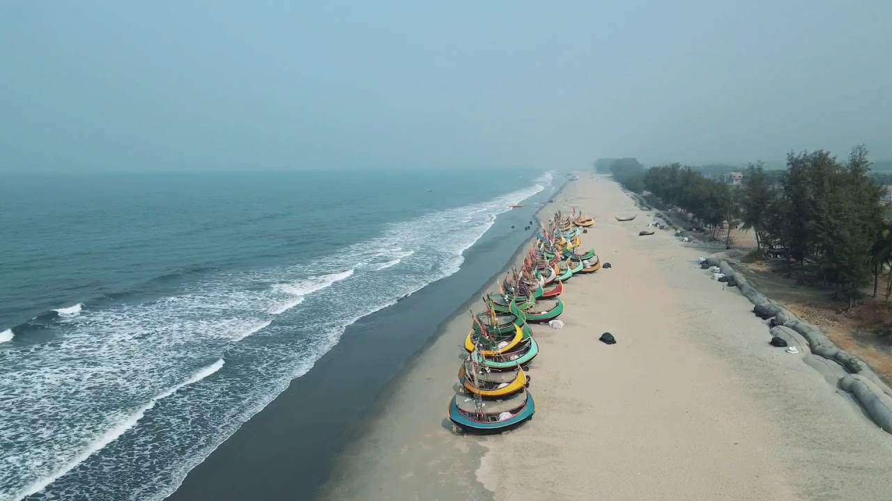

Cox’s Bazar
Cox's Bazar, located in Bangladesh, is home to the world's longest natural sea beach, stretching over 120 kilometers. Renowned for its serene beauty and golden sands, it attracts tourists from around the globe.

Slide 4
Sundarban
The Sundarbans, a UNESCO World Heritage Site, is the largest mangrove forest in the world, spanning Bangladesh and India. It is home to the majestic Royal Bengal Tiger and a rich diversity of flora and fauna.

Slide 5
Shylhet
Sylhet's tea gardens, nestled in the lush hills of northeastern Bangladesh, are a picturesque blend of vibrant greenery and rolling landscapes. Renowned for producing high-quality tea, they offer a tranquil retreat for nature lovers and travelers.

Slide 6
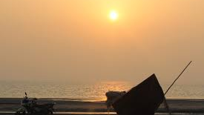
Kuakata
Sylhet, known for its lush tea gardens and spiritual shrines, is a picturesque region in northeastern Bangladesh. Kuakata, often called the "Daughter of the Sea," offers stunning panoramic views of both sunrise and sunset over the Bay of Bengal.

Slide 7
Bandarban
Bandarban, a picturesque district in Bangladesh, is famed for its lush green hills, waterfalls, and tribal cultures. It offers breathtaking views, with attractions like Nilgiri, Boga Lake, and the majestic Sangu River.

